Slide 1
CCS2 – Workshop 7 (Week 8) Experiment Analysis
4/19/2021

Slide 2
Types of result analysis
Descriptive analysis: what results do we have?
- Present your result through table and figures
Diagnostic analysis: why we have these results?
- Explain the results based on your understanding of the approach
Prescriptive analysis: what should be done next?
- Discuss the limitation of the approach
Predictive analysis: what will happen then?
- Discuss future research direction

Slide 3
Experiments in Scientific Research
What task do you choose to perform, and why?
What result do you expect from running this experiment? (What is your hypothesis, and why?)
What datasets do you choose, and why?
What baselines do you compare with, and why?
What figure do you choose to visualize the result, and why?
How do you highlight the main findings in table/figure?
Is the table/figure easily comprehensible?
Design
Implement
Present
Discuss/
Analysis
What tools do you use to implement the experiment?
Do you follow another work’s experiment setting?
How do you ensure that the comparison is fair?
What does the result mean?
Does the result support your hypothesis?
Is there any unexpected result, and why?
Is there any limitation on the experiment?

Slide 4
Questions to answer - Table
What do you want to express through the table?
What metric do you use in the table, and why?
How many columns, how many rows does the table contain?
Which data do you highlight in the table?
What additional statistical data do you present?

Slide 5
Example
Title: Inductive Representation Learning on Large Graphs (NIPS 2017)
Summary: proposed an inductive node embedding framework named GraphSAGE, where it learns a function that generates embedding by sampling and aggregating features from a node’s local neighbourhood.

Slide 6
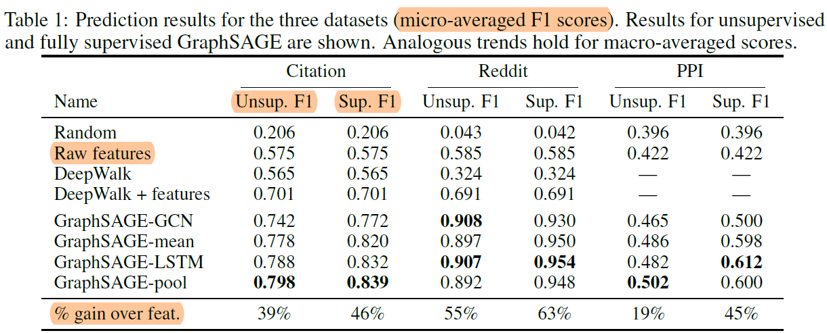
Table
What do you want to express through the table?
-Our proposed framework GraphSAGE outperforms other baselines remarkably.
-Our framework works well both in unsupervised learning and in supervised learning.
What metric do you use in the table, and why?
-Micro-averaged F1 scores, because it is one of the standard metric for multiclass classification task.
How many columns, how many rows does the table contain?
-7 columns and 10 rows. First column is the eight methods including 4 baselines and 4 variants of GraphSAGE. …
Which data do you highlight in the table?
-The method with the highest micro-averaged F1 score are put in bold
What additional statistical data do you present?
-The last row “% gain over feat.” We would like to emphasise the importance of network structural information.

Slide 7
Activity 1 Result analysis plan - Table
Group
30 mins
Devise your experiment analysis plan (what elements to include?)
Based on your experiment results (or expected results) design your experiment result table(s).
- For each table:
What do you want to express through the table?
What metric do you use in the table, and why?
How many columns, how many rows does the table contain?
Which data do you highlight in the table?
What additional statistical data do you present?
……

Slide 8
Questions to answer - Figure
What do you want to express through this figure?
What type of figure do you choose to use, and why?
What do x-axis and y-axis represent in the figure?
What are the units for the two axes?
Are the units in log scale or linear scale?
……

Slide 9
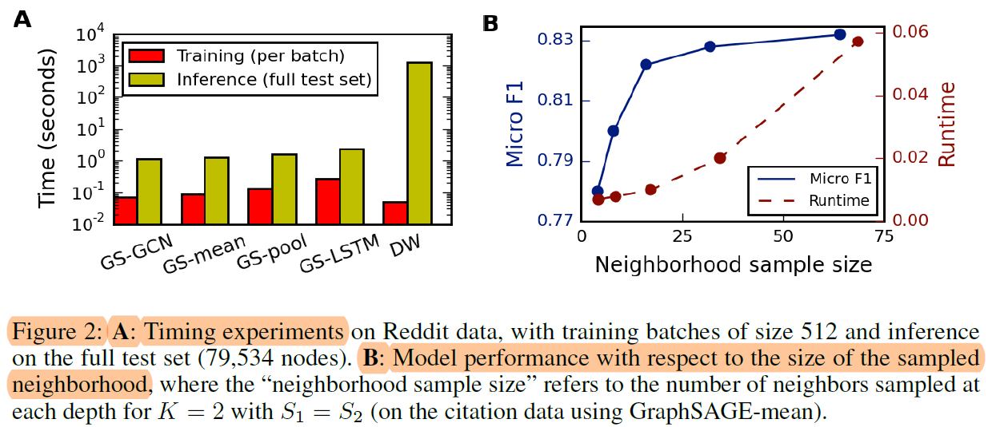
Figure
What do you want to express through this figure (these figures)?
We plan to use two figures to present our analysis of the experiment result.
First figure compares the training time and test time of our framework with the Deepwalk approach.
Second figure shows how the choice of sample size will influence the result and runtime.
What type of figure do you choose to use, and why?
- We will use a bar chart in the first figure, because it is a good way of performing a comparison of metric
values across different groups of the data. ……
What do x-axis and y-axis represent in the figure? What are the units for the two axes?
- In the first figure, x-axis is different methods, y-axis is time in seconds. ……
Are the units in log scale or linear scale?
- y-axis (time in seconds) is in linear scale

Slide 10
Activity 2 Result analysis plan - Figure
Group
30 mins
Based on your experiment results (or expected results) design your experiment result figure(s).
- For each figure:
What do you want to express through this figure?
What type of figure do you choose to use, and why?
What do x-axis and y-axis represent in the figure?
What are the units for the two axes?
Are the units in log scale or linear scale?
Share your analysis plan on canvas (include the plan, the design of table and the design of figure)

Slide 11
Activity 3 Feedback on Analysis Plan
Between groups
20 mins
Each group provides some feedbacks on another group’s result analysis plan.
Comment on canvas
The Plants
Blarglefargle
Phish and Chips

Slide 12
Activity 4 What is a good analysis plan
Group
20 mins
Create a list of main characteristics that a good result analysis plan should have.
- Share your list on Canvas.

Slide 13
Assessment task 2 due on April 19
- Review of the project proposal
Individual task
< 1000 words
 | Assessment Criteria | Weight
1 | Appropriately identify and discuss main advantages | 25
2 | Appropriately identify and discuss main shortcomings | 25
3 | Properly construct argument | 25
4 | Clarity and fluency | 25

